Slide 1
Lab Work
Name of the experiment: Perform DOS attack
Dr. Abdullah-Al-Musa
(B.Sc(Hons) In Computing, M.Engg In Information System Security , PhD)
Department of Computer Science & Engineering
Bangladesh University of Business and Technology (BUBT)

Slide 2

Legal Disclaimer
In addition, this is teaching purpose the Lab exercise and this does not condone malicious behavior of any kind inside the Lab.
Your are on notice, that continuing and/or using this lab outside is your "own responsibility“ and test environment is considered malicious and is against the law such as Bangladesh Digital Security Act 2018 , Bangladesh Information and Communication Technology Act 2006 .
Dr.Abdullah© 2021 -- no content should be replicated and it is not allowed without express written permission.

Slide 3
Introduction:
A Denial-of-Service (DoS) attack is an attack meant to shut down a machine or network, making it inaccessible to its intended users. DoS attacks accomplish this by flooding the target with traffic, or sending it information that triggers a crash. In both instances, the DoS attack deprives legitimate users (i.e. employees, members, or account holders) of the service or resource they expected.

Slide 4
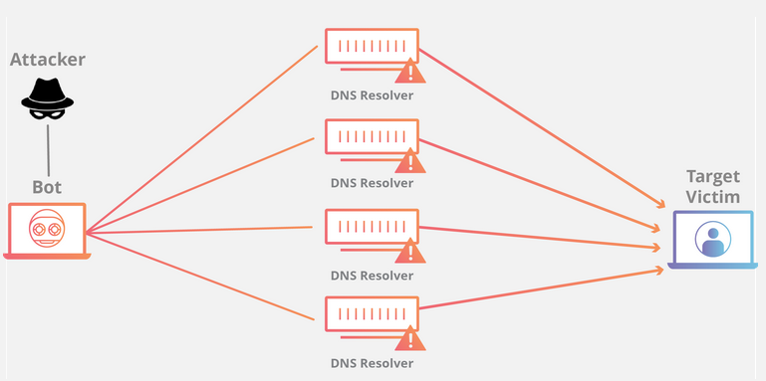
Figure : Showing DOS attack

Slide 5
Figure : Showing DOS attack

Slide 6
The primary focus of a DoS attack is to oversaturate the capacity of a targeted machine, resulting in denial-of-service to additional requests. The multiple attack vectors of DoS attacks can be grouped by their similarities.
DoS attacks typically fall in 2 categories:

Slide 7
Buffer overflow attacks:
An attack type in which a memory buffer overflow can cause a machine to consume all available hard disk space, memory, or CPU time. This form of exploit often results in sluggish behavior, system crashes, or other deleterious server behaviors, resulting in denial-of-service.

Slide 8
Flood attacks:
By saturating a targeted server with an overwhelming amount of packets, a malicious actor is able to oversaturate server capacity, resulting in denial-of-service. In order for most DoS flood attacks to be successful, the malicious actor must have more available bandwidth than the target.

Slide 9
What are some historically significant DoS attacks?
Historically, DoS attacks typically exploited security vulnerabilities present in network, software and hardware design. These attacks have become less prevalent as DDoS attacks have a greater disruptive capability and are relatively easy to create given the available tools. In reality, most DoS attacks can also be turned into DDoS attacks.

Slide 10
How can you tell if a computer is experiencing a DoS attack?
While it can be difficult to separate an attack from other network connectivity errors or heavy bandwidth consumption, some characteristics may indicate an attack is underway.
Indicators of a DoS attack include:
Atypically slow network performance such as long load times for files or websites
The inability to load a particular website such as your web property
A sudden loss of connectivity across devices on the same network

Slide 11
What is the difference between a DDoS attack and a DOS attack?
The distinguishing difference between DDoS and DoS is the number of connections utilized in the attack. Some DoS attacks, such as “low and slow” attacks like Slowloris, derive their power in the simplicity and minimal requirements needed to them be effective.

Slide 12
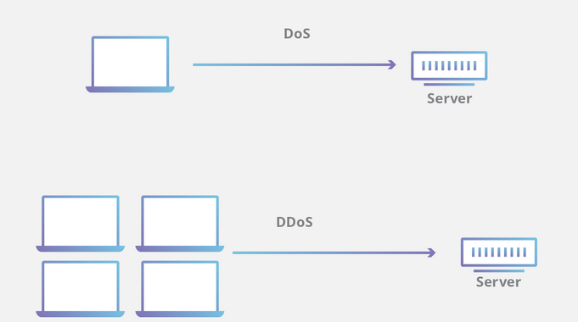

Slide 13
DoS utilizes a single connection, while a DDoS attack utilizes many sources of attack traffic, often in the form of a botnet. Generally speaking, many of the attacks are fundamentally similar and can be attempted using one more many sources of malicious traffic. Learn how Cloudflare's DDoS protection stops denial-of-service attacks.

Slide 14
LAB WORK

Slide 15
Step1 :At first open your kali linux terminal

Slide 16
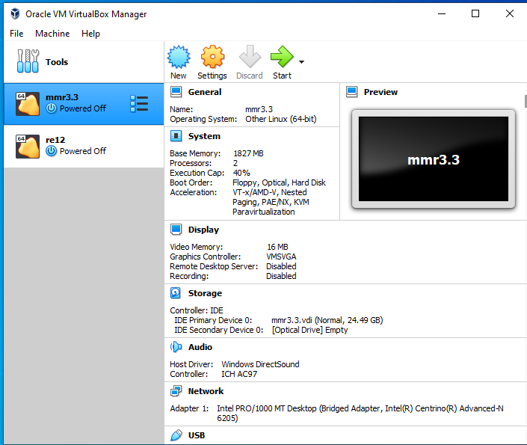

Slide 17
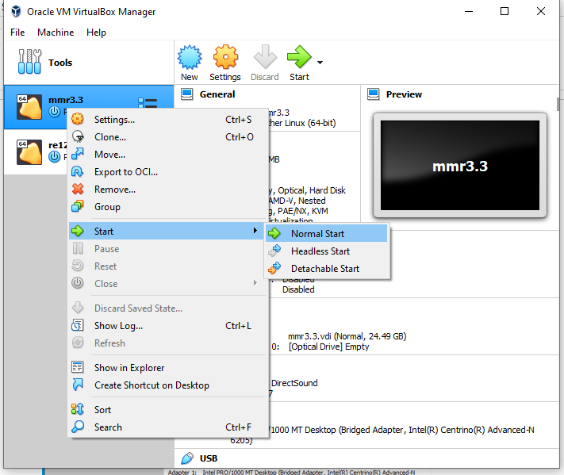

Slide 18
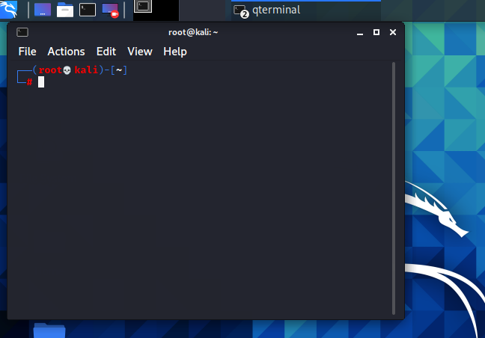

Slide 19
Step 2: Now open your browser and go to pentmenu git hub site . Actually this is the driver , that we will install in kali linux and will perform DOS attack.

Slide 20
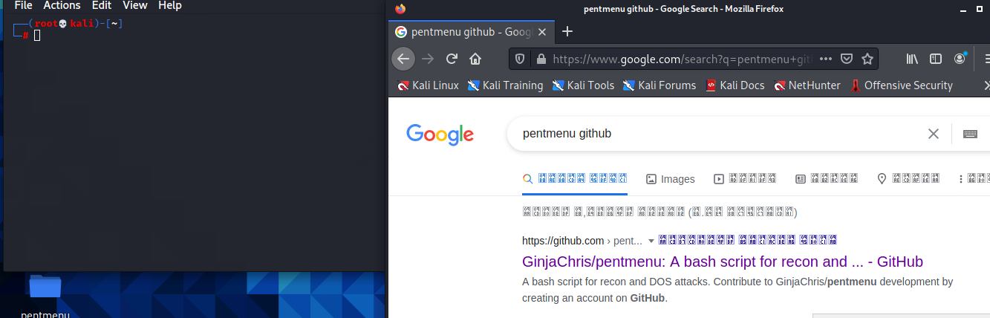

Slide 21
In that case we only need the url:

Slide 22
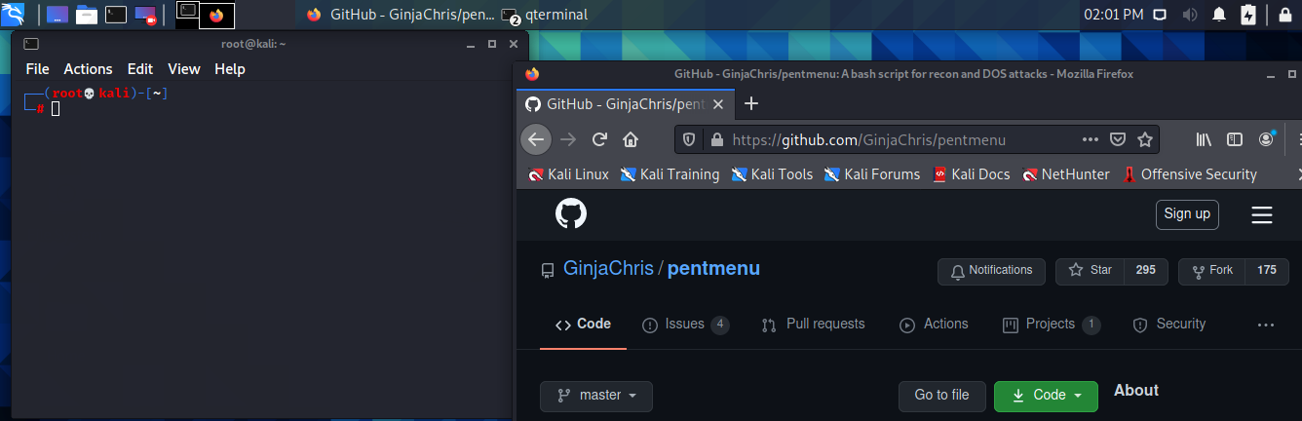

Slide 23
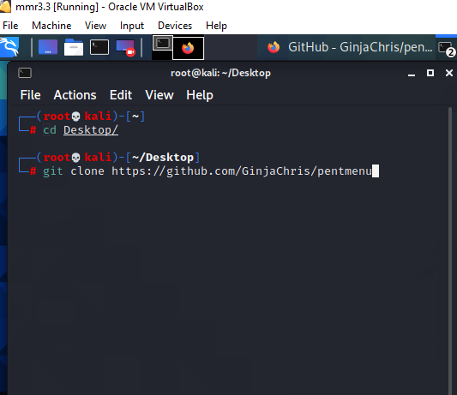

Slide 24
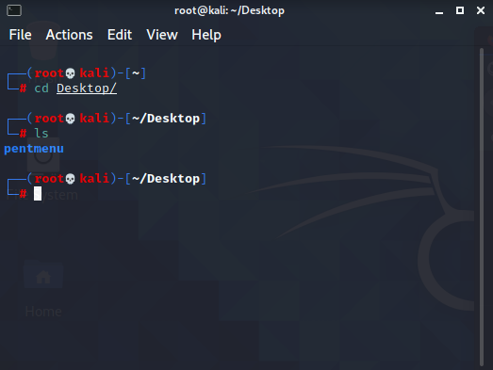

Slide 25
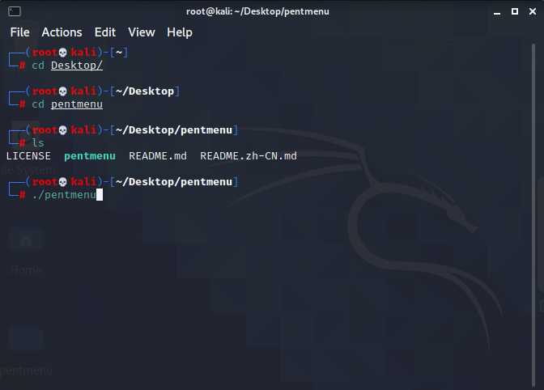

Slide 26
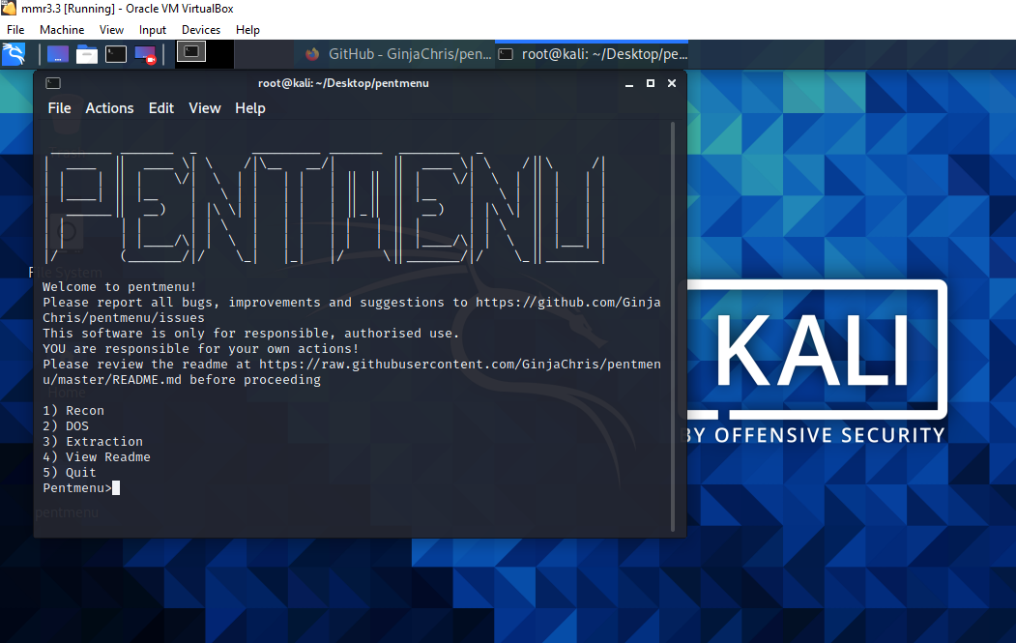

Slide 27
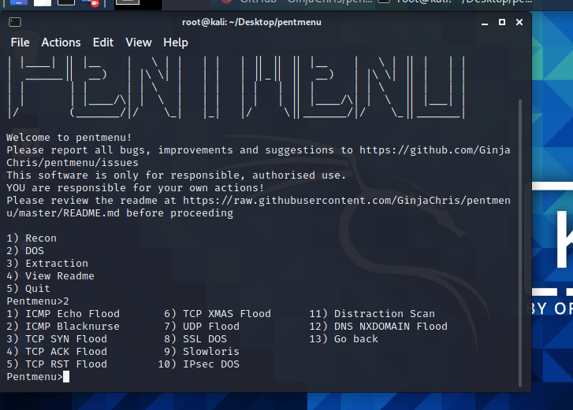

Slide 28
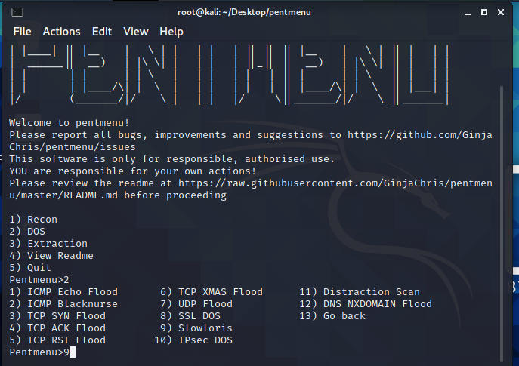

Slide 30
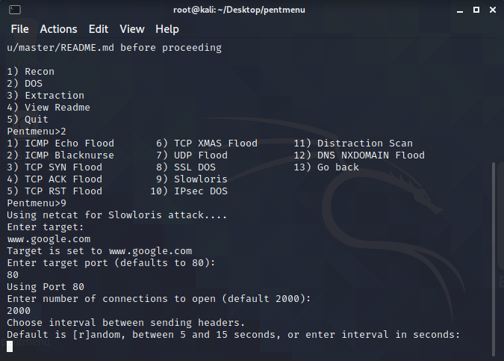

Slide 31
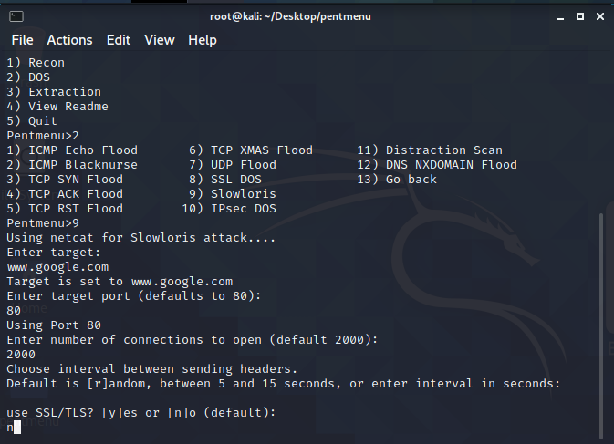

Slide 32
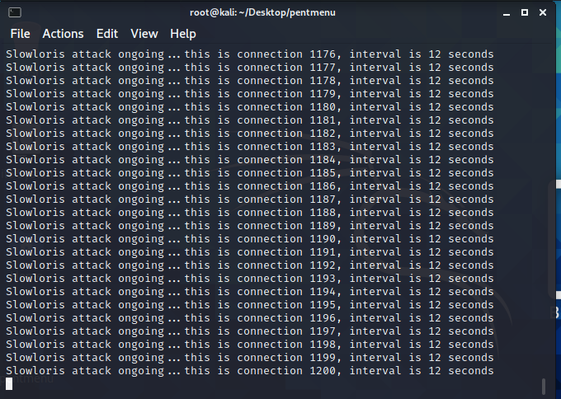

Slide 33
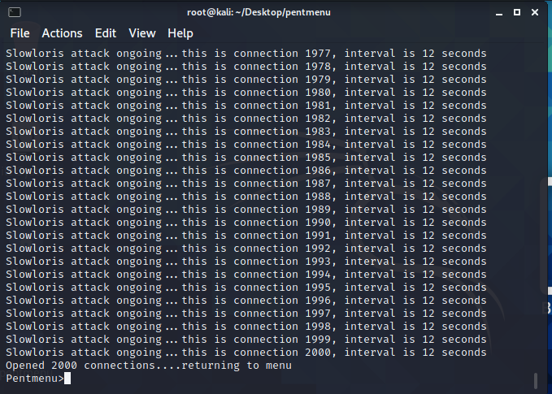
This is how we preform DOS attacks , the attacks happened on 12 seconds and
Send unnecessary 2000 packet to slow the google site

Slide 34
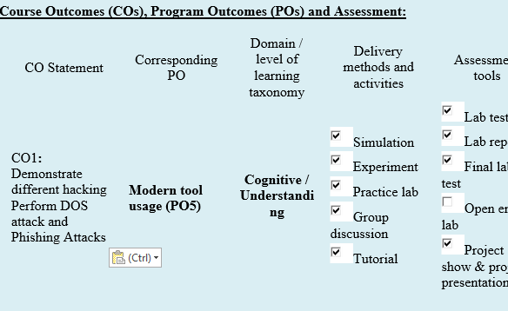

Slide 35
Lab Exercise :

